Slide 1
CytoAutoCluster
A Study of Mass Cytometry in Cells
- Aman Jayswal

Slide 2
Table of Contents
01
Project Overview
02
Selecting the Right Dataset
03
EDA Techniques
04
Visualizing Data
05
Data Corruption and Splitting
06
Machine Learning Models
07
Semi-Supervised Learning & Metrics
08
Visualizations and Gradio Demo

Slide 3
1
Project Overview
CytoAutoCluster is an advanced solution for clustering cells based on unique characteristics. Using semi-supervised learning, it enhances clustering accuracy and computational efficiency, providing valuable insights into cellular data.
Key Features:
Semi-Supervised Learning: Leverages both labelled and unlabelled data to enhance clustering accuracy.
Efficient Cell Grouping: Segments cells into distinct clusters based on nuanced features.
Optimized for Performance: Handles large datasets with speed and precision.
Interpretability: Visualizes and explains cluster distributions clearly.
Scalability: Manages large, complex datasets without compromising performance.
Photo by Pexels

Slide 4
2
Selecting the Right Dataset
Criteria for dataset selection:
Documentation and context.
Number of samples and feature types.
Checking for biases.
Conduct Exploratory Data Analysis (EDA) to confirm dataset suitability.
Photo by Pexels

Slide 5
3
EDA Techniques
Null vs Non-Null Values:
Bar plot visualization.
Importance: Identify missing data for imputation or removal strategies.
Class Label Distribution:
Bar plot visualization.
Importance: Understand class balance.
Photo by Pexels

Slide 6
4
EDA Techniques
Histograms of Numerical Features
Assessing patterns like normality, skewness, and outliers.
Box Plots and Count Plots
Visualizing distributions, medians, and outliers.
Space for histogram and box plot placeholders
Photo by Pexels

Slide 7
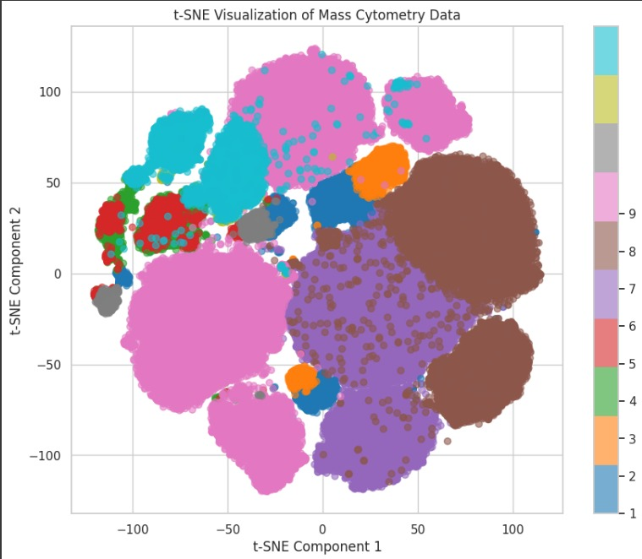
5
Visualizing Data
Correlation Matrix: Heatmap analysis for relationships between features. Skewness and Kurtosis Analysis: Understanding asymmetry and outlier impact. t-SNE Visualization: Dimensionality reduction for visualizing clusters and patterns.
Photo by Pexels

Slide 8
6
Data Corruption and Splitting
Binary Mask and Corrupted Data Analysis: Synthetic corruption testing for robustness.
Data Splitting: Labeled data split: 70% training, 30% testing.
Photo by Pexels

Slide 9
7
Machine Learning Models
Logistic Regression: Baseline model with interpretability.
XGBoost: Robust classification performance. Future Goal: Advanced modeling strategies like Autoencoders.
Photo by Pexels

Slide 10
8
Semi-Supervised Learning & Metrics
Semi-Supervised Techniques: Leveraging Autoencoders for feature extraction.
Performance Metrics: Evaluation criteria for model effectiveness.
Accuracy : 0.9354
AUROC : 9955
Photo by Pexels

Slide 11
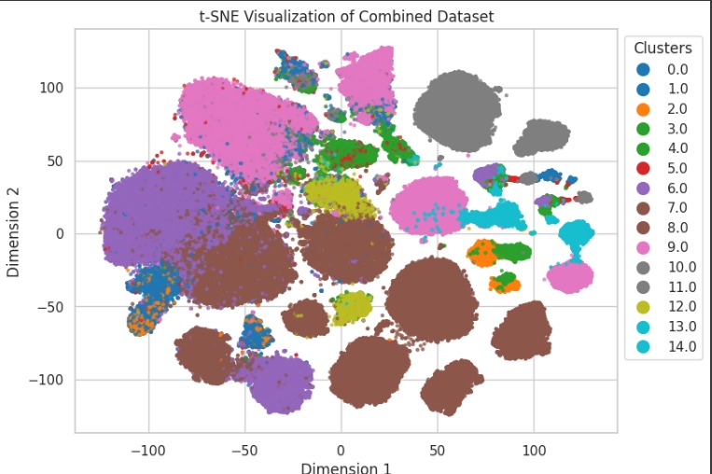
9
Visualizations and Gradio Demo
Final t-SNE Visualization: Post-modeling clustering results.
Gradio Demo: Interactive interface for predictions and analysis.
Photo by Pexels

Slide 12
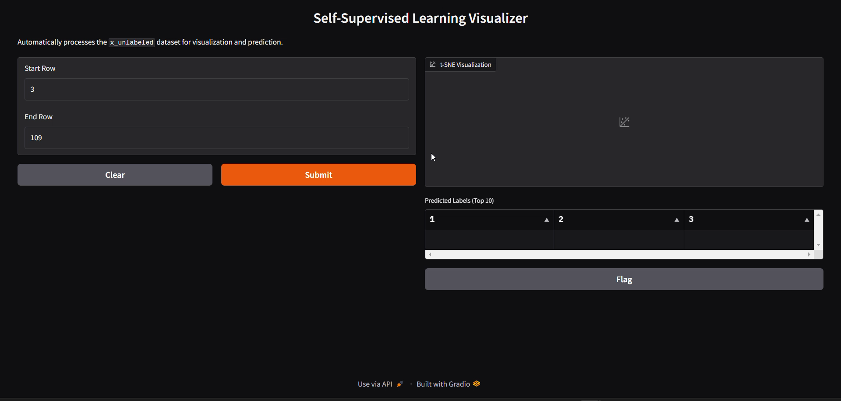
GRADIO Output

Slide 13

From:- Aman Jayswal

